Slide 1


Analog Transmission

Slide 2






5-1 DIGITAL-TO-ANALOG CONVERSION
Process of changing one of the characteristics of an analog signal :
Based on the information in digital data.

Slide 3
5-1 DIGITAL-TO-ANALOG CONVERSION
Aspects of Digital-to-Analog Conversion
Amplitude Shift Keying
Frequency Shift Keying
Phase Shift Keying

Slide 4
Digital to Analog Conversion
Digital data needs to be carried on an analog signal.
Carrier signal (frequency f_{c}) performs the function of:
Transporting the digital data in an analog waveform.

Slide 5
Digital to Analog Conversion
The analog carrier signal is manipulated to :
Uniquely identify the digital data being carried.

Slide 6
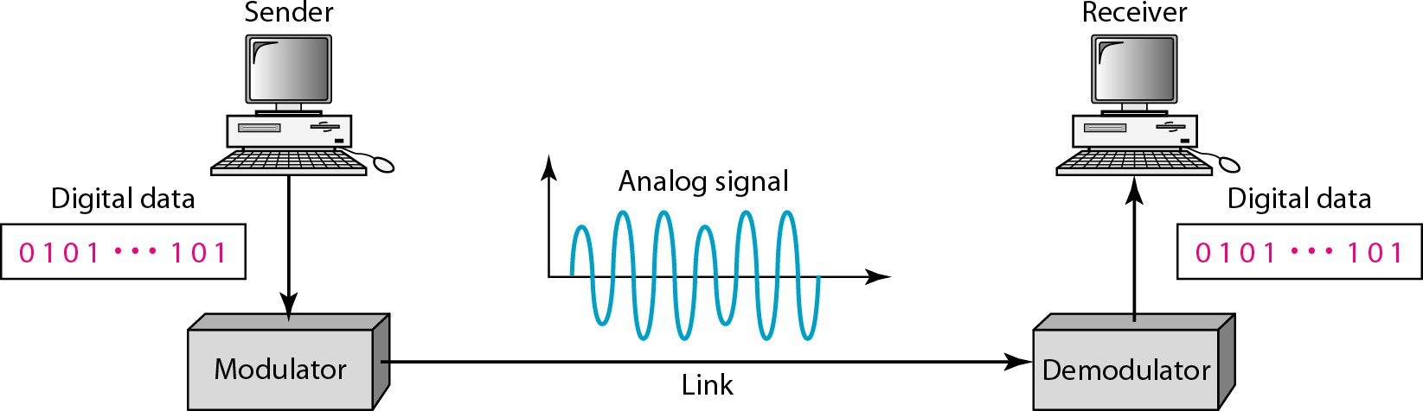
Figure 5.1 Digital-to-analog conversion

Slide 7
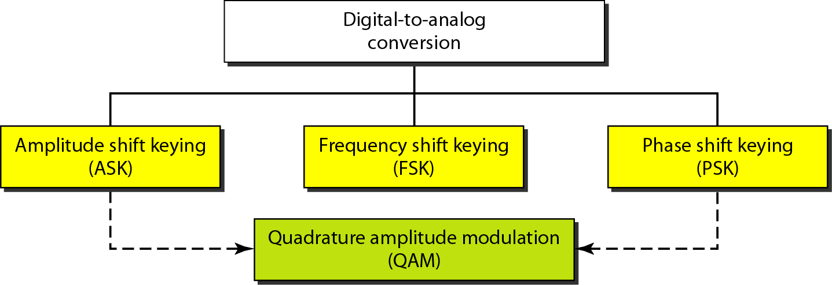
Figure 5.2 Types of digital-to-analog conversion

Slide 8




1. Bit rate: N is the number of bits per second (bps). 2. Baud rate: Number of signal
elements per second (bauds).
Note

Slide 9
Note
In Analog transmission of digital data, the signal or baud rate is:
Less than or equal to the bit rate.
S=Nx1/r bauds
r is the number of data bits per signal element.

Slide 10
Example 5.1
An analog signal carries 4 bits per signal element. If 1000 signal elements are sent per second, find the bit rate.
Solution
In this case, r = 4, S = 1000, and N is unknown. We can find the value of N from

Slide 11
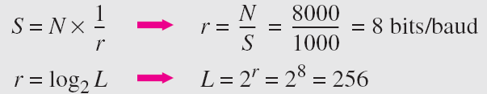
Example 5.2
An analog signal has a bit rate of 8000 bps and a baud rate of 1000 baud. How many data elements are carried by each signal element? How many signal elements do we need?
Solution
In | this |  | example, |  | S | = | 1000, |  | N = |  | 8000, | and | r | and
L are |  | unknown. |  | We | find |  |  | first |  | the | value | of | r | and
then |  | the value |  | of | L.

Slide 12
Amplitude Shift Keying (ASK)
ASK is implemented by:
Changing the amplitude of a carrier signal.
For example:
Digital “1” could not affect the signal
Digital “0” would, by making it zero.
Notes:
ASK is implemented by:
Changing the amplitude of a carrier signal to reflect amplitude levels in the digital signal.
For example: a digital “1” could not affect the signal, whereas a digital “0” would, by making it zero.
.

Slide 13
Amplitude Shift Keying (ASK)
The line encoding will determine the values of:
Analog waveform to reflect the digital data being carried.

Slide 14
Bandwidth of ASK
Bandwidth B of ASK is proportional to the signal rate S.
B = (1+d)S
“d” is due to modulation and filtering, lies between 0 and 1.

Slide 15
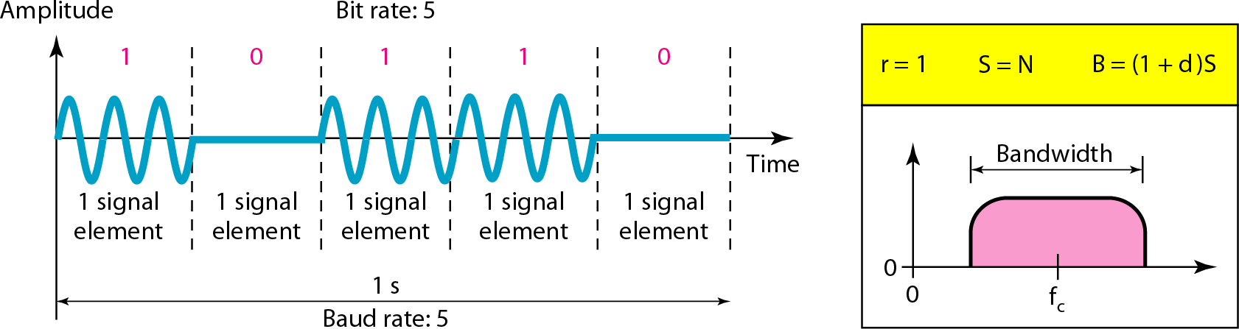
Figure 5.3 Binary amplitude shift keying

Slide 16
Frequency Shift Keying
Digital data stream changes:
Frequency of the carrier signal, f_{c}.
For example
“1” could be represented by f₁=f_{c} +Δf,
“0” could be represented by f₂=f_{c}-Δf.

Slide 17
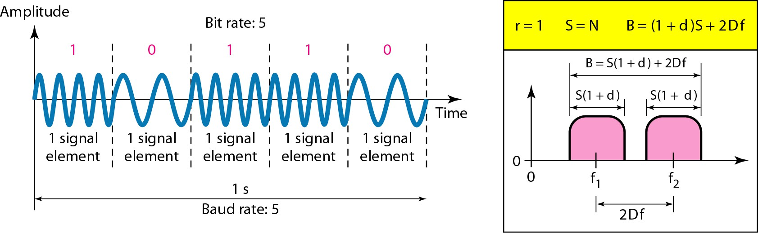
Figure 5.6 Binary frequency shift keying

Slide 18
Bandwidth of FSK
Difference between the two frequencies (f₁ and f₂) is 2Δf,
Then the required BW B will be:
B = (1+d)xS +2Δf
Notes:
Extra term
2Δ𝑓2Δf because two (or more) carrier frequencies are used.
Δf = frequency separation between carriers.
Bandwidth depends on both signal rate and frequency deviation.
Example: For
𝑆=1kbaud, 𝑑=0.5,Δ𝑓=3 kHz
S=1kbaud,d=0.5,Δf=3kHz,
B=1.5kHz+6kHz=7.5kHz.

Slide 19
Example 5.5
We have an available bandwidth of 100 kHz which spans from 200 to 300 kHz. What should be the carrier frequency and the bit rate if we modulated our data by using FSK with d = 1?
Solution
This problem is similar to Example 5.3, but we are modulating by using FSK. The midpoint of the band is at 250 kHz. We choose 2Δf to be 50 kHz; this means

Slide 20
Phase Shift Keyeing
Vary the phase shift of the carrier signal :
To represent digital data.
The bandwidth requirement, B is: B = (1+d)xS

Slide 21
Phase Shift Keyeing
PSK is much more robust than ASK:
As it is not that vulnerable to noise.
Notes:
As it is not that vulnerable to noise, which changes amplitude of the signal

Slide 22
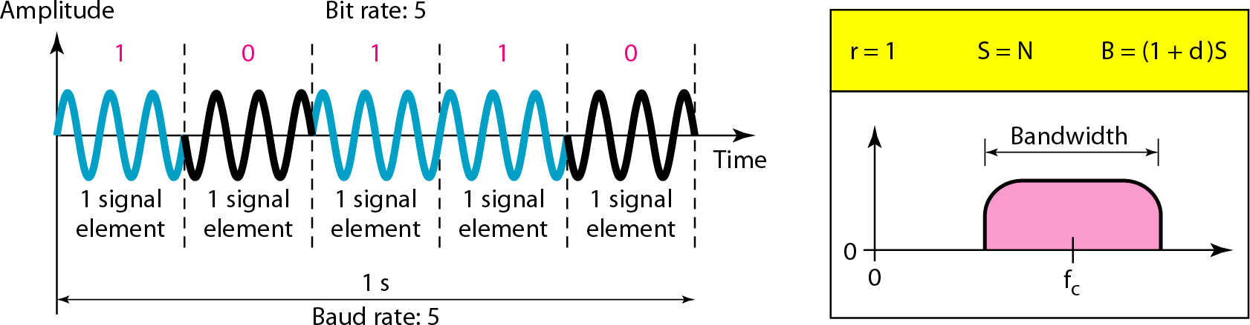
Figure 5.9 Binary phase shift keying

Slide 23
🎉 Q2: My signal is learning karate!
Guess the blank and make it a black belt:
In Phase Shift Keying (PSK), we change the __________ of
the carrier to represent data.
Frequency
Phase
Amplitude
Notes:
Answer: phase
Justification:
PSK modifies the phase of the carrier wave to encode digital bits. It’s more noise-resistant than ASK, making it ideal for real-world communication.

Slide 24
🤔 Q1: Oh no!
My signal's going analog!
Help me out by filling in the blank:
Digital-to-Analog conversion changes the __________ of a
carrier signal to represent digital data.
Characteristics
Signal
Notes:
Answer: characteristics
Justification:
Digital-to-Analog conversion modifies one or more characteristics (amplitude, frequency, or phase) of an analog carrier signal in order to embed digital information.

